Slide 1
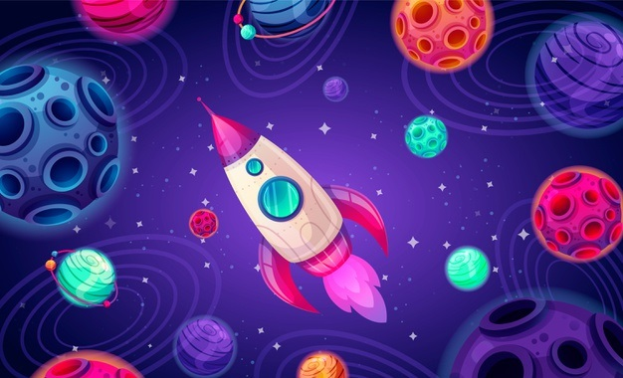
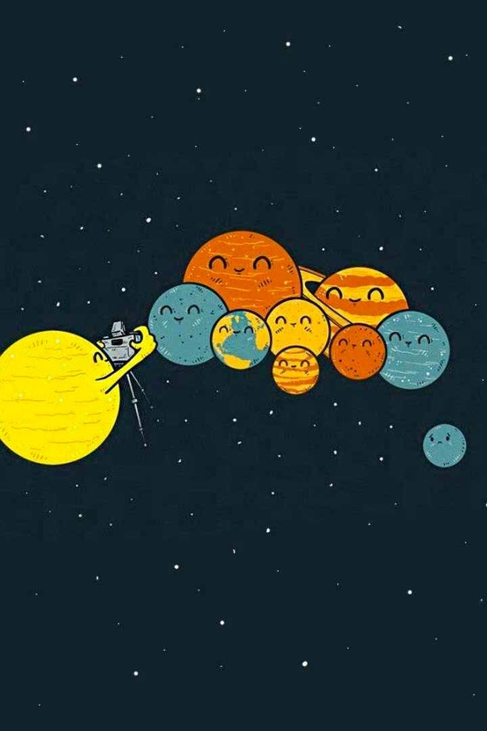
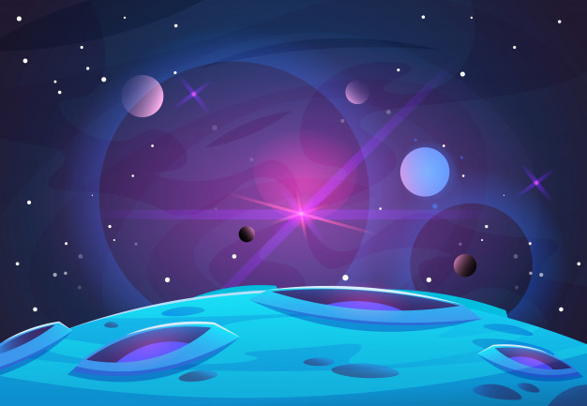
In the Name of God
Chapter 1: The Origin of the Universe

Slide 2
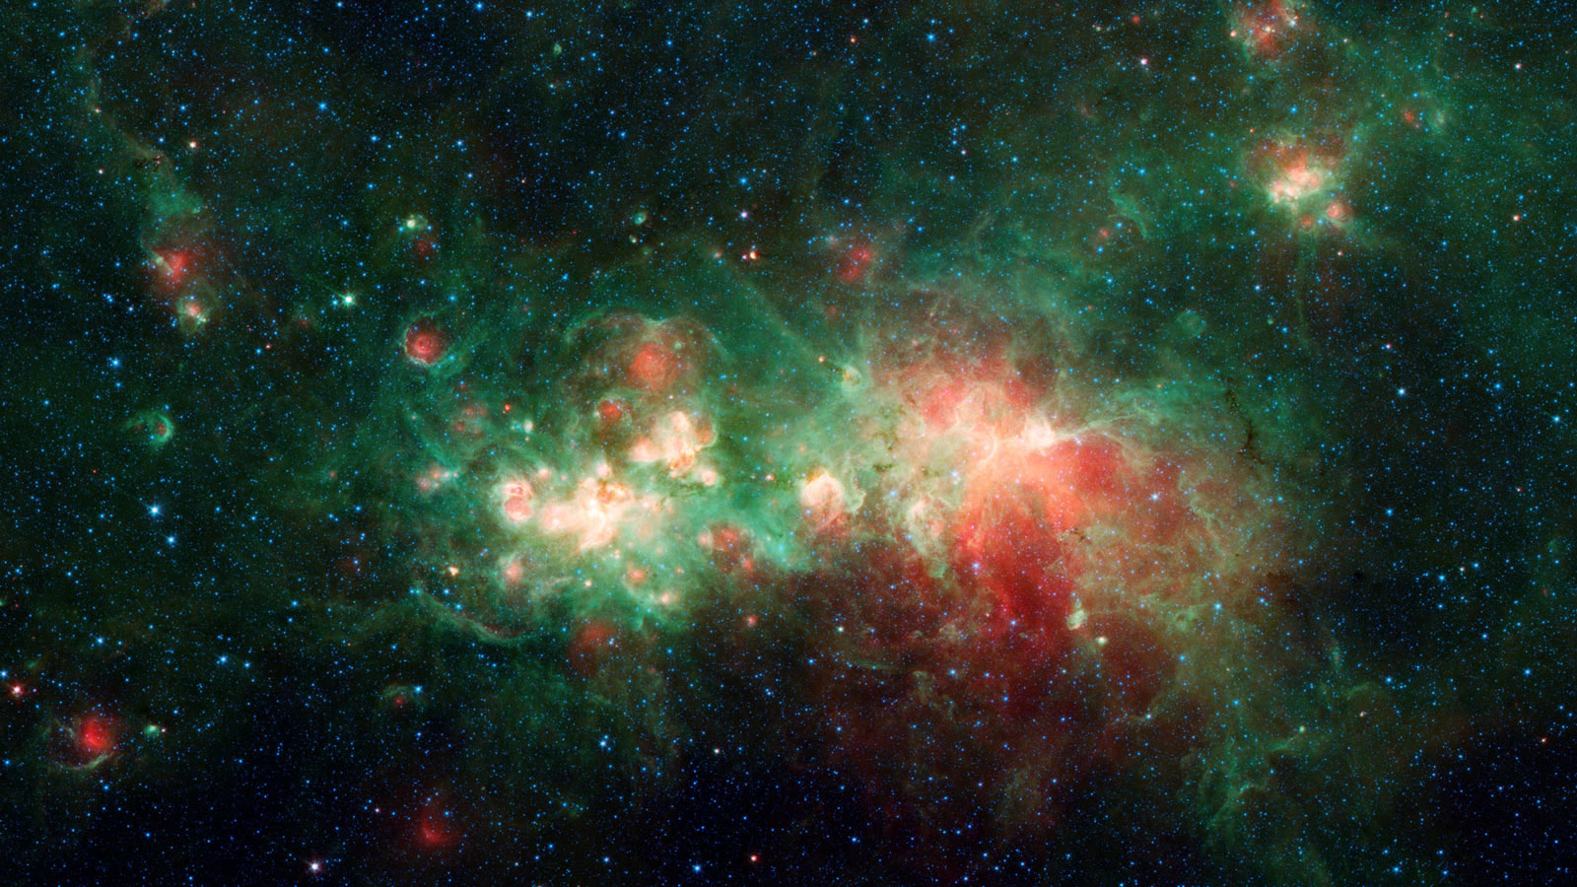
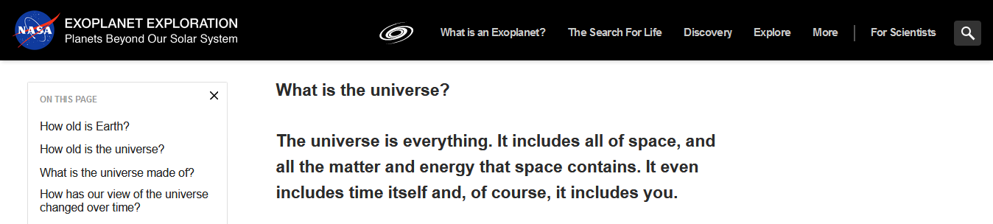
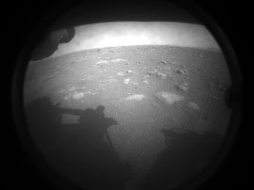
Chapter 1: The Origin of the Universe

Slide 3

Reading Strategy 1: USING HEADINGS AS GUIDES
Headings in a passage can work as guides
A passage may contain one main heading and some subheadings
All the paragraphs under a subheading address the same topic
Universe, the Earth, and Life
What does ‘Universe’ imply?
The Big Bang Theory
Plate Tectonics and Continents Formation
Life Formation on the Earth

Slide 4
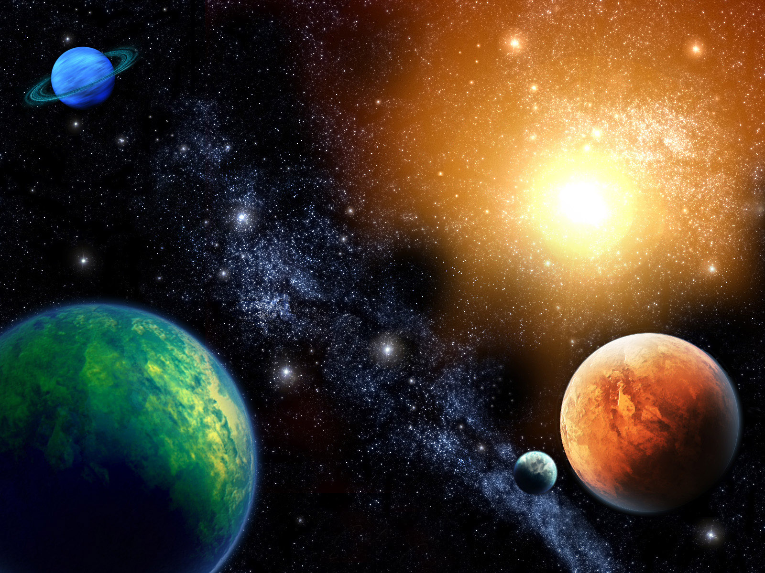
Universe, the Earth, and Life
What does ‘Universe’ imply?
We use the word 'universe' to mean everything that exists; from the Earth to the most distant parts of space that astronomers can possibly see. People used to think that the Earth was the centre of the universe. Although the Earth is important to us, we know now that it is a little planet going round the sun, which is just one of millions of ordinary stars in our galaxy. The universe contains countless galaxies of stars. The furthest ones we can see are so distant that their light takes thousands of millions of years to reach us. This delay means that we are seeing them now as they actually were long ago. We can also tell that the galaxies are rushing apart.

Slide 5
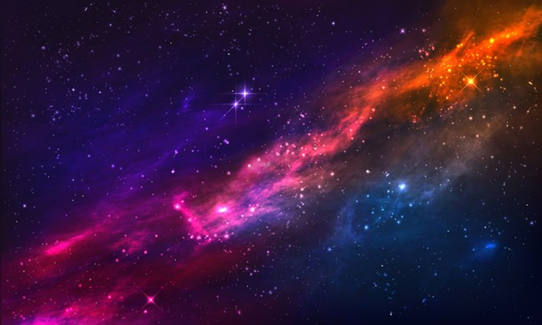
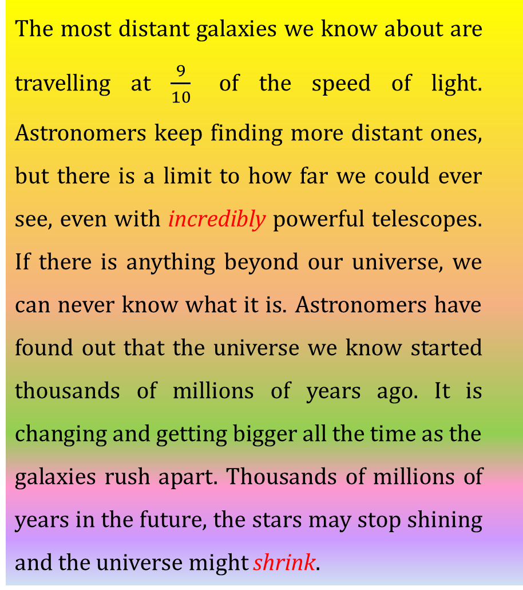
The most distant galaxies we know about are travelling at $\frac{9}{10}$ of the speed of light. Astronomers keep finding more distant ones, but there is a limit to how far we could ever see, even with incredibly powerful telescopes. If there is anything beyond our universe, we can never know what it is. Astronomers have found out that the universe we know started thousands of millions of years ago. It is changing and getting bigger all the time as the galaxies rush apart. Thousands of millions of years in the future, the stars may stop shining and the universe might shrink.

Slide 6
What does “universe” imply?
Universe: everything that exists
The Earth is not the center of the universe (it is a little planet in the galaxy)
The universe contains countless galaxies of stars
Distant parts of the universe are hardly visible to the astronomers
Galaxies are rushing apart
Now: The universe is expanding Future: The universe might shrink

Slide 7
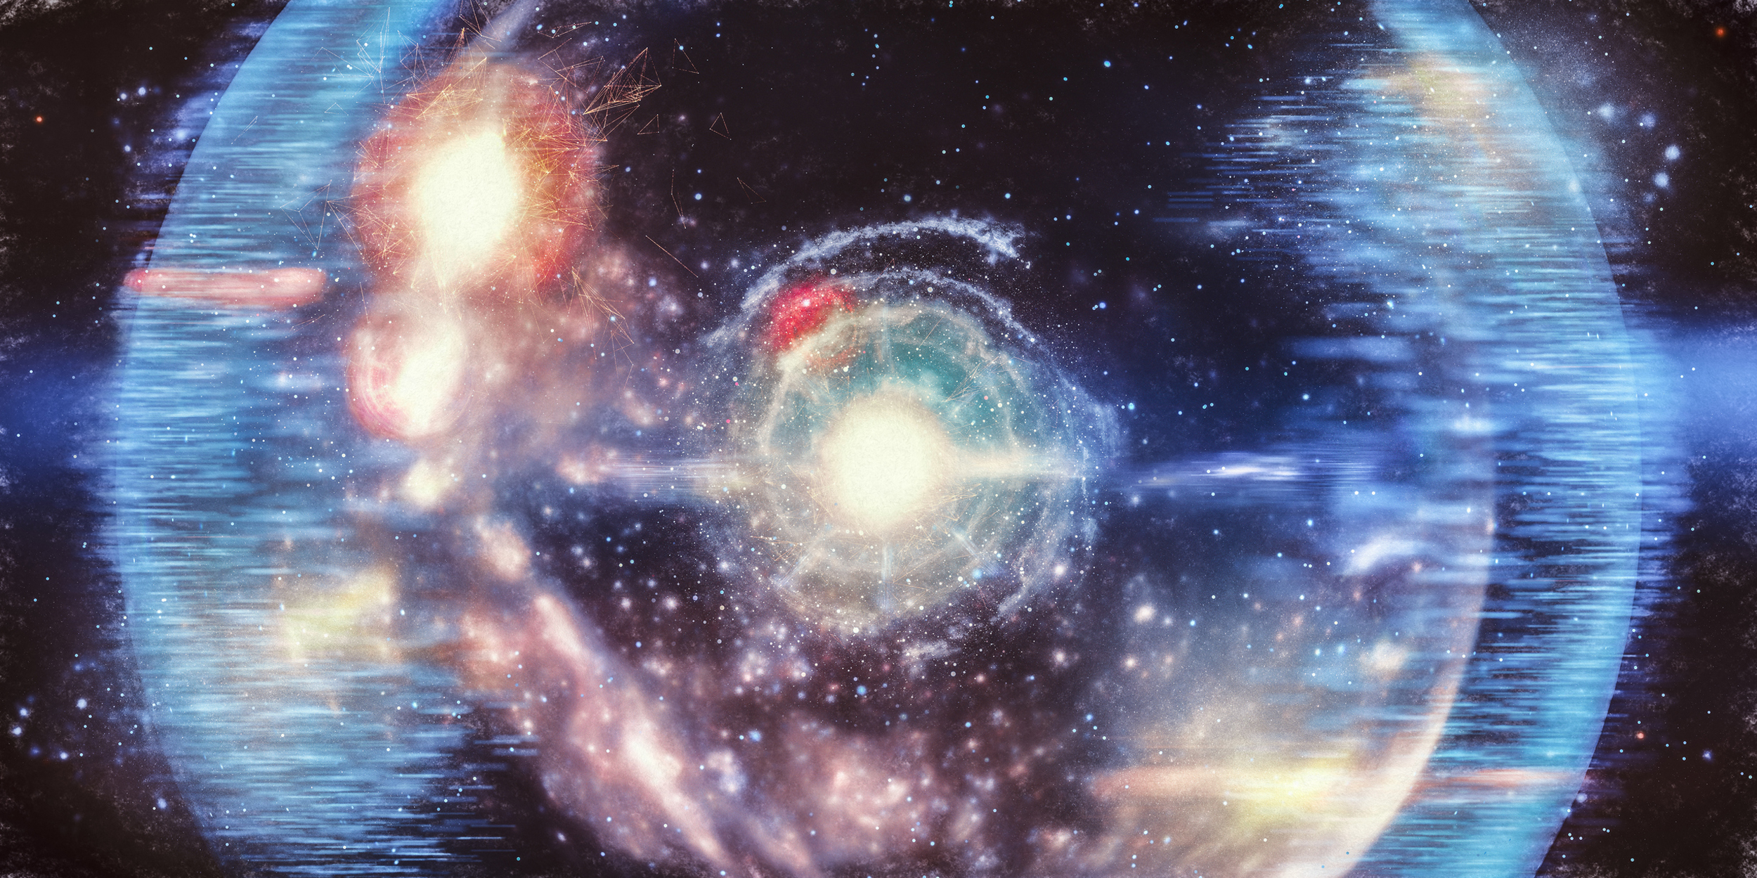
The Big Bang Theory
Most scientists believe that the universe started thousands of millions of years ago with an event that they call the ‘Big Bang’. It was some kind of explosion in which all the matter and energy in the universe was created. At first, the universe was incredibly dense and hot. Later, as it expanded outwards, the galaxies and the stars formed. The whole universe has continued expanding since the Big Bang. Scientists are fairly sure that the theory is right since they found a faint radio signal that seems to fill all of space. The only explanation for the radio signal is that it is the energy left over from the Big Bang.

Slide 8
The Big Bang theory
Explosion
Universe was dense and hot
Evidence: a faint radio signal

Slide 9
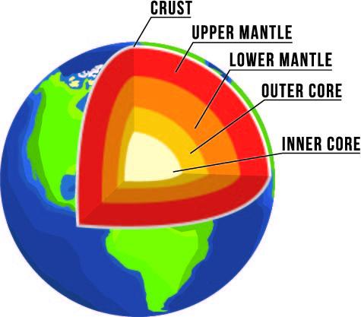

Plate Tectonics and Continents Formation
The explanation of what has happened to the surface of the Earth is known as ‘Plate Tectonics’. The skin or ‘crust’ of the Earth is about 70 km thick and is divided into plates that float on the slushy part of the second layer or the ‘mantle’. Plates move slowly (a few centimeters each year) over the Earth’s surface. Over millions of years this has caused continents to split apart and collide.

Slide 10
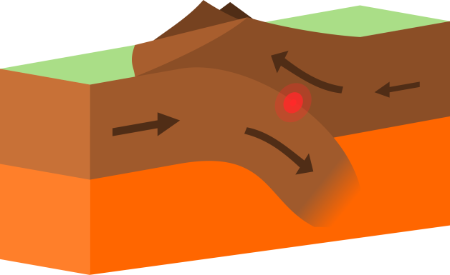
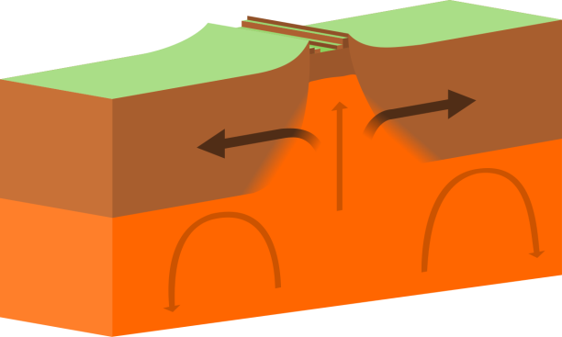
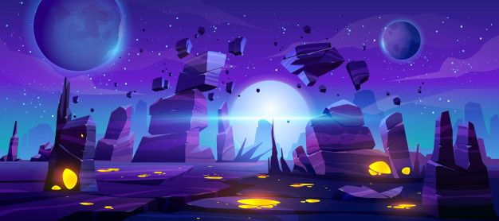
On some parts of the ocean floor, plates pull apart. New crust is formed when molten material from undersea volcanoes rises to fill the gaps. There are other plate boundaries where one plate is pushed under another. These areas also have volcanoes and earthquakes. In other places plates scrape sideways, splitting the crust.
Similar fossils of ferns and reptiles have been found in South America, Africa, India, and Antarctica. These could not have crossed the oceans, so they must have lived on the same land at some time in the past. If you cut out the continents on a world geological map and put them together like a ‘jigsaw puzzle’, you can match rock formations. This is not a coincidence. The rocks were formed when the land was a single continent. This continent, which geologists call Pangaea, split and the separate parts moved to their present positions.

Slide 11
Plate tectonics and continents formation
Surface of the Earth
Crust and mantle
Jigsaw puzzle
Slow movement of plates caused the continents split apart

Slide 12
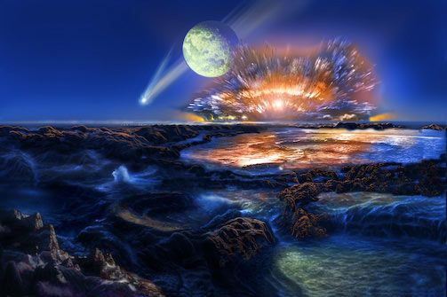
Life Formation on the Earth
When the Earth was first formed, there was no life at all. The surface of the Earth was very hot then, and nothing could have lived. It took about 1,000 million years for the Earth to become suitable for life. It is very hard to imagine how life could arise from non-living things. For years, biologists could not understand how the very complicated plants and animals, including ourselves, could have come from simple chemicals.

Slide 13
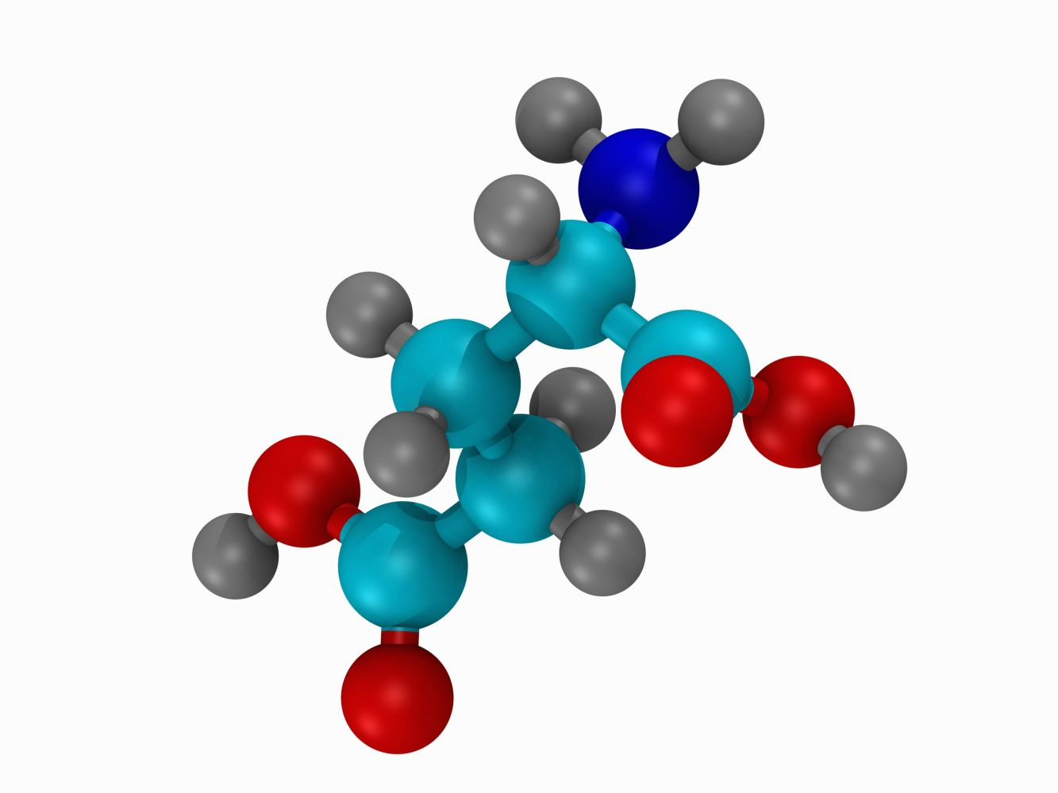
Scientists think that life arose from chemicals that entered the atmosphere from volcanoes, thousands of millions of years ago. Geologists can tell from ancient rocks that these chemicals included hydrogen, methane, ammonia, and water. Experiments have shown that these chemicals will form into molecules called amino acids quite easily. Amino acids are the building blocks of proteins, and proteins are the main substances of living things. Experiments in laboratories have suggested that lightning and radiation from the Sun triggered the formation of amino acids. These dissolved in the oceans where, over millions of years, they formed proteins and then simple cells.

Slide 14
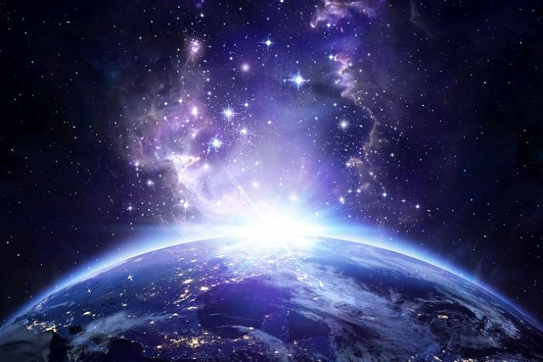
These simple cells were like small bags of protein with an outer membrane which could take in (feed) other chemicals and divide to form new cells (reproduce). The oldest fossils that have been discovered are 3,500 million years old.

Slide 15

Life formation
No life on Earth
Life could arise from non-living things.
How?
Chemicals
Molecules (amino acids)
Proteins
Cells

Slide 16
Choose the best option for the following items:
The main substance of living things is …….…………….
cells
b) amino acids
c) proteins
d) water
2. According to the text, …….……………
everything on the Earth is universe
the center of the universe is not known
everything that exists is universe.
d) the Sun is a galaxy in the universe.

Slide 17
3. The movement of the skin of the earth is …….…………… .
sharp and splitting
slow and constant
rapid and damaging
fast and floating
4. The reason accounting for the Big Bang Theory comes from …….…………… .
a) continuous expansion of the universe
b) the energy existing around us
c) faint radio signals filling the space
d) highly dense and hot gases

Slide 18
5. Identical fossils …….…………… in the past.
a) have lived in different places of the world c) have crossed the oceans
b) must have lived on the same land d) must have cut out the continents
6. What was the main push behind formation of amino acids?
a) Experimental laboratories c) Lightning and sun rays
b) Protein absorption d) Living things around us

Slide 19
Statement Accuracy. Decide if the following statements are True (T), False (F), or Not Given (NG).
The theory of Plate Tectonics describes the history of the Earth surface. T
2. Fossils of reptiles found in Africa have crossed the oceans. F
3. Life originated in living things at about 1000 million years ago. F
4. Hydrogen, methane, ammonia, and water form amino acids and these,
in turn, form proteins and these, in turn, make simple cells. T
5. There is a great number of stars in the whole universe. T
6. Biologists very easily found that human beings are made of molecules. F

Slide 20


